Slide 1

Kamui 2
Thomas Szirtes
Senior Software Engineer
Sega Europe
Szirtest@soe.sega.co.uk
Dts@soe.sega.co.uk

Slide 2
Kamui2
Basics
Multi-pass
Multiple rendering
Bump mapping
Accumulation Buffer
Video Display Modes
  PAL 50/60, Strip buffers

Slide 3
Basics

Slide 4
Kamui2
If you are not using Kamui2 - why not?!
  Ports from Kamui1 very easily
  Great performance benefits
    Asynchronous rendering flow (NO WAIT VSYNC)
    Optimised handling of vertex contexts
  Low level but still “future proof”
Notes:
Ports from Kamui 1 - stories I hear from game developers are that it typically takes just one day or less.
ASYNCHRONOUS RENDERING - allows the user task to continue to calculate the next set of coordinates after a kmRender() without having to wait for the VSYNC.
OPTIMIZED HANDLING OF VC - Processing render states is slow. Now has the ability to change just one parameter without having to process entire state.
Also header???

Slide 5
Kamui Flow
SH4
3 Stage Model
PVR
CORE
Vertex
buffers
Native
buffer
Frame
buffer
Models
TA
textures
System memory
Video memory
Notes:
Here is a reminder of the flow of information around the Dreamcast.
In Kamui1 this was previously referred to as the 3VB Latency Model, this is because the each stage was locked to the vertical blank.

Slide 6
Kamui Flow
SH4
2 Stage Model
PVR
CORE
Vertex
buffers
Native
buffer
Frame
buffer
Models
TA
textures
System memory
Video memory

Slide 7
Flow - Init
Initialise Kamui
  kmInitDevice (KM_DREAMCAST);
  kmSetDisplayMode (mode, frame, bdither, bantialias);
  kmSetWaitVsyncCount (count);
Set up the system configuration
  KMSYSTEMCONFIGSTRUCT
  buffer sizes, latency, transfer mechanisms
  kmSetSystemConfiguration(&config)

Slide 8
Flow - Render Loop
Begin Scene
Begin Pass
Register all vertex data
  Start Strip (contains render state)
  Register Vertex Data
  End Strip
End Pass
End Scene

Slide 9
Flow - Render loop
Render
Flip Frame Buffers
Repeat

Slide 10
Contexts
Fill out Strip Context structure
  texture, blending, clipping etc..
Generate Strip Header
    kmGenerateStripHeadXX ( )
Passed with Start Strip command
Creating a Strip header is expensive
  pre-process if possible
  small changes use
    kmChangeStripXXXXXXXX ( )

Slide 11
Macros
Most efficient way to send vertex data
  Use Store Queue
  Uses incremental linear writes
  No repetition of data
  Potential tight integration with render engine

Slide 12
Macros
Process
  Grab pointer to vertex buffer
    kmxxGetCurrentPtr( desc )
  Send strip header
    kmxxStartStrip( pdesc, pheader )
  Send vertex data
    kmxxSetVertex_X( pcw, … )
  Release pointer to vertex buffer
    kmxxReleaseCurrentPtr( desc )

Slide 13
Multi-pass

Slide 14
Multi-pass
Not talking about multi-texturing
Allows application to split registration of vertex data
  decreases vertex buffer in system memory
  can change scene global parameters
  native buffer size not decreased
  render still performed once

Slide 15
Multi-pass
For each pass can specify
  Translucent Sorting Mode
  To clear the z-buffer
  System vertex buffer
    buffer pointer
    buffer size
    allocation for each list type
  List for direct transfer
Notes:
Effectively this is a whole new system configuration

Slide 16
Multi-pass
Implementation
  System configuration
    Specify number of passes (nPassDepth)
    fill out pass info structure for each pass
      SystemConfig.Pass[n]
  BeginPass()/EndPass()
    number of passes must match the pass depth specified
    alternatively can use ContinuePass() = EndPass(); BeginPass(); as shortcut
Notes:
CONTINUE PASS - equivalent to BeginPass() and EndPass()

Slide 17
Multi-pass
Flow
kmBeginScene(&systemconfig)
kmBeginPass(&vertexbufferdesc)
// vertex registration pass 1
kmEndPass()
kmBeginPass(&vertexbufferdesc)
// vertex registration pass 2
kmEndPass()
kmRender(KM_RENDER_FLIP)
kmEndScene(&systemconfig)

Slide 18
Multi-pass
Techniques
  Speed up of translucent processing
    Swap between pre-sort/auto-sort
    group translucent objects together
  Z Clipping plane
    Three pass technique
      Pass 1 - draw distant view model
      Pass 2 - draw transparent Z clipping polygon, use ALWAYS as z buffer comparison
      Pass 3 - draw close up model
Notes:
Explain PRESORT/AUTOSORT

Slide 19
Multi-render

Slide 20
Multiple Renders
Can call kmRender multiple times
  Split Screen games
  Render to texture effects
Reduces native buffer requirement
Cannot produce composite renders easily
  Due to PowerVR design
  Need to render to texture

Slide 21
Multiple Renders
Flow
kmSetPixelClipping( area1 )
kmBeginScene()
kmBeginPass/kmEndPass // Pass 1
[ kmBeginPass/kmEndPass ] //any other passes...
kmRender(KM_RENDER_NOFLIP) //Don’t flip
kmEndScene()
kmSetPixelClipping( area2 )
kmBeginScene()
kmBeginPass/kmEndPass // Pass 1
[ kmBeginPass/kmEndPass ] //any other passes...
kmRender(KM_RENDER_FLIP) // Render and Flip
kmEndScene()

Slide 22
Multiple Renders
Render to Texture
  substitute kmRenderTexture
    kmRenderTexture(pTextureSurface, dwDitherMode)
  Target texture
    Rectangle/Stride Format
      not twiddled of course

Slide 23
Accumulation Buffer

Slide 24
Accumulation Buffer
What is it?
  On-chip image of tile (32*32)
  32 bit ARGB
Dreamcast has two of them:
  Primary
    sent to frame buffer
  Secondary
    “off-line”

Slide 25
Accumulation Buffer
Specified in Vertex Context
pStripContext->ImageControl[KM_IMAGE_PARAM1].bSRCSelect
pStripContext->ImageControl[KM_IMAGE_PARAM1].bDSTSelect
  SRC Select
    FALSE = Use texels as source
    TRUE = Use secondary buffer as source
  DST Select
    FALSE = Use primary buffer as destination
    TRUE = Use secondary buffer as destination

Slide 26
Accumulation Buffers
Why?
  Complex multi-texturing
  Translucent Trilinear Polygons
  Translucent Bump-mapped/Textured Polygons
  Translucent Gloss Maps
  Maybe stencil type effects
Notes:
Though PVR doesn’t have multitexturing abilities as such – you can do unlimited number of passes/layers.

Slide 27
Accumulation Buffers
Processed TEXELS
Secondary
Accumulation Buffer
PRIMARY
Accumulation Buffer
SRC Select
DST Select
Alpha Blending Unit
FRAME BUFFER

Slide 28
Accumulation Buffers
Processed TEXELS
Secondary
Accumulation Buffer
PRIMARY
Accumulation Buffer
SRC Select = FALSE
DST Select = FALSE
Alpha Blending Unit
FRAME BUFFER
NORMAL OPERATION

Slide 29
Accumulation Buffers
Processed TEXELS
Secondary
Accumulation Buffer
PRIMARY
Accumulation Buffer
SRC Select = FALSE
DST Select = TRUE
Alpha Blending Unit
FRAME BUFFER
TRILINEAR PASS A&B

Slide 30
Accumulation Buffers
Processed TEXELS
Secondary
Accumulation Buffer
PRIMARY
Accumulation Buffer
SRC Select = TRUE
DST Select = FALSE
Alpha Blending Unit
FRAME BUFFER
TRANSLUCENT TRILINEAR FLUSH
Notes:
Texture is ignored so used non-textured vertex type

Slide 31
Bump Mapping

Slide 32
Bump mapping
Perturbed Normal
  dot product between light and normal vector
One pass non-textured
Modulates the alpha

Slide 33
Bump mapping
Texture Format
  BUMP format as output from PVRCONV
    polar angles expressing normal line vector
    S,R Values compacted to 16bits
      S : 0° - 90° : 0x00 - 0xFF
      R : 0° - 360° : 0x00 - 0xFF

Slide 34
Bump mapping
Angle S
Angle R

Slide 35
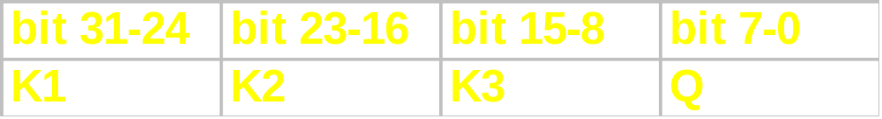
Bump mapping
Light Vector
  uses same method as normal vector
    T : 0° - 90° : 0x00 - 0xFF
    Q : 0° - 360° : 0x00 - 0xFF
  encode in vertex offset colour
    K1 = 1 - strength
    K2 = strength * sin(t’)
    K3 = strength * cos(t’)
0.0f - 1.0f : 0x00 - 0xFF

Slide 36
Bump mapping
Render State
  Offset (Specular) mode = TRUE
  pStripContext->StripControl.bOffset = KM_TRUE;
  Blending Mode
Pitfalls
  Careful with texture mapping
  Have to transfer light into texture coordinate space

Slide 37
Video Modes

Slide 38
Video Modes
PAL 60Hz
  Full Screen/”Full” Speed
  Hardware trick
  Use kmDisplayMode() to select equivalent NTSC screen mode
  Refer to Sega Standards
Notes:
This hardware trick is used by the video machines also.

Slide 39
Video Modes
Full Screen PAL 50Hz Code
kmSetPALEXTCallback(PALExtCallbackFunc,NULL);
kmSetDisplayMode (KM_DSPMODE_PALNI640x480EXT,… );
VOID STATIC PALExtCallbackFunc(PVOID pCallbackArgs)
{
PKMPALEXTINFO pInfo;
pInfo = (PKMPALEXTINFO)pCallbackArgs;
pInfo->nPALExtMode = KM_PALEXT_HEIGHT_RATIO_1_133;
return;
}

Slide 40
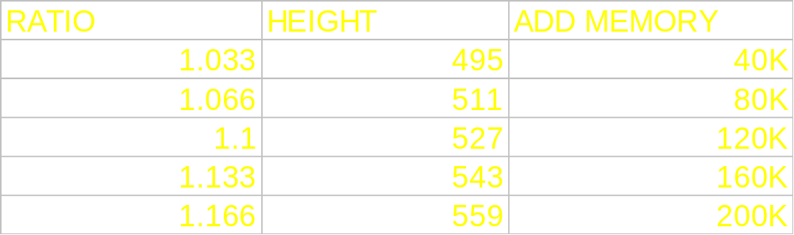
Video Modes
Full Screen PAL 50Hz
  does not affect rendering performance
  increases frame buffer requirement
Memory figures for VGA 640x480

Slide 41
Video Modes
Strip Buffer
  SystemConfig.flags = KM_CONFIGFLAG_ENABLE_STRIPBUFFER;
  2 Buffers (width*strip height)
Buffer 1
vscan
Buffer 2
display
Buffer 1
render
Buffer 2

Slide 42
Video Modes
Strip Buffer
  Reduce Frame Buffer Size
  Easy to set-up
  Very difficult to get working well
    Draw Time < Display Time
    May be render time inefficient

Slide 43
Golden Rules
Use Macro’s Level 5
Optimise render state changes
Mipmap
VQ
Use Presort if drawing translucent sprites/multi-texturing
Use Punch-through where applicable
Use Asynchronous render mode

Slide 44
Q&A

